Slide 1
Incident Response Information System
IRIS
Developed by Episoft Ltd

Slide 2
Overview
Introduction
Data Management
Design
IRIS terminology
Quick Tour
Deep dive into IRIS

Slide 3
Introduction
Masood Sujau
Software Engineer
Previously worked for EpiSoft for 7 years.
Currently working as a consultant, developer and trainer
Email: masood.sujau@haloratech.com

Slide 4
Introduction
IRIS is a web-based secure multi-user data management and analysis platform.
Notes:
We will go into the details of each of the words next

Slide 5

Introduction
Web-based system
Uses internet web technologies to deliver information and services to users.
System is accessed using a web browser
IRIS supports all the major browsers but we recommend using Google Chrome
Notes:
IRIS is a server product. It is not installed on your PC. You access it through the internet.

Slide 6
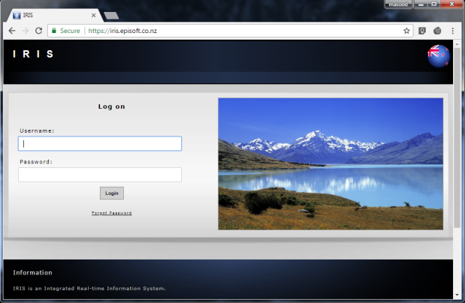
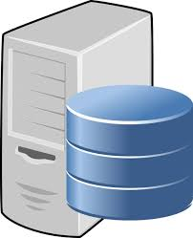

Introduction
Secure system
Encrypted connection between client and server
Requires a logon to access the system
Protects and controls data access
Notes:
Episoft hosts 2 IRIS systems a demo and a live system. The majority of Episoft’s clients are governments and they tend to host their own systems.

Slide 7





Introduction
Multi-user system
System is designed to be used by a number of people simultaneously
Notes:
You can be inputting data into the system at the same time as you colleagues and you can view each others data if the system is set up so.

Slide 8
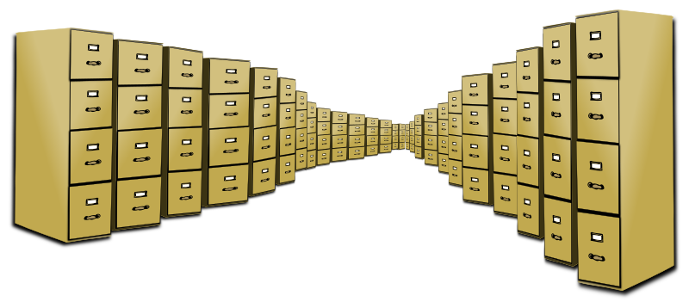
Introduction
Data management system
Data is a valuable resource
Ability to store, validate, organise, protect, deliver and enhance the value of data and information assets

Slide 9
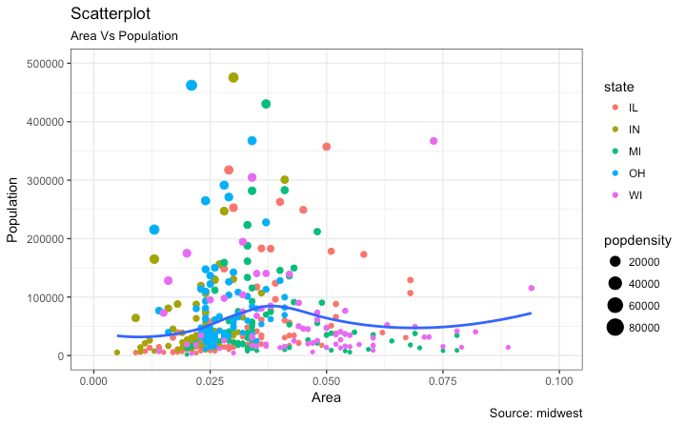
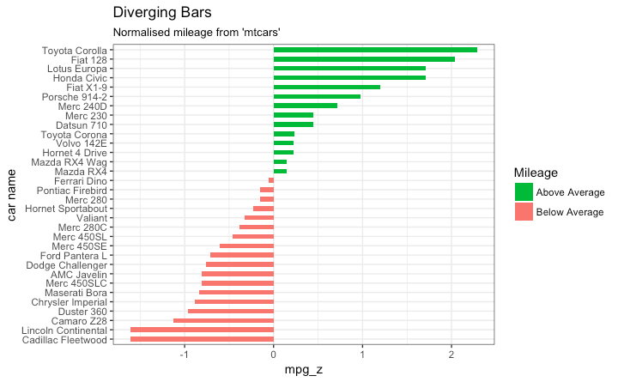
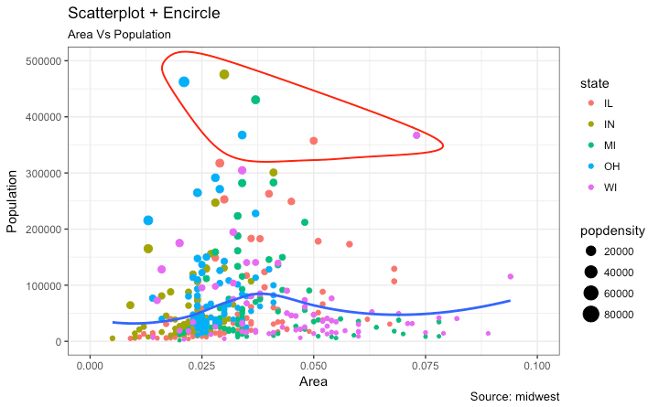
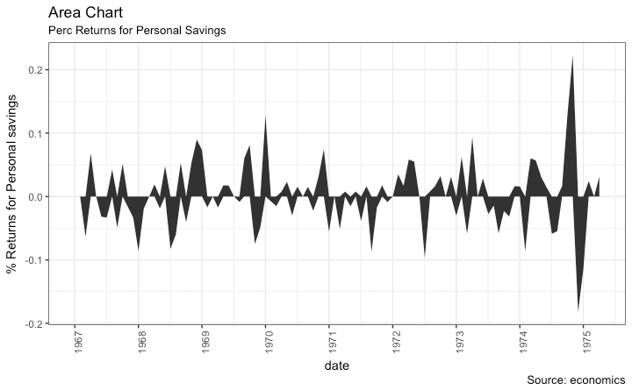
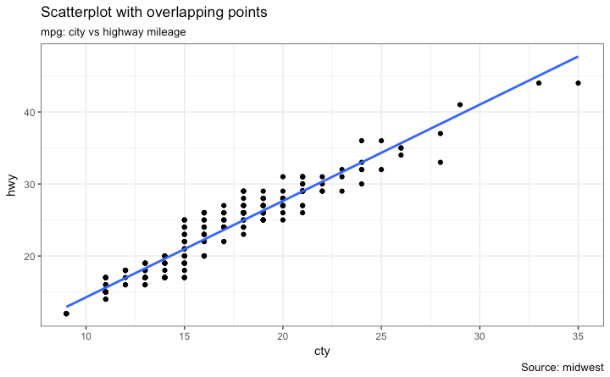
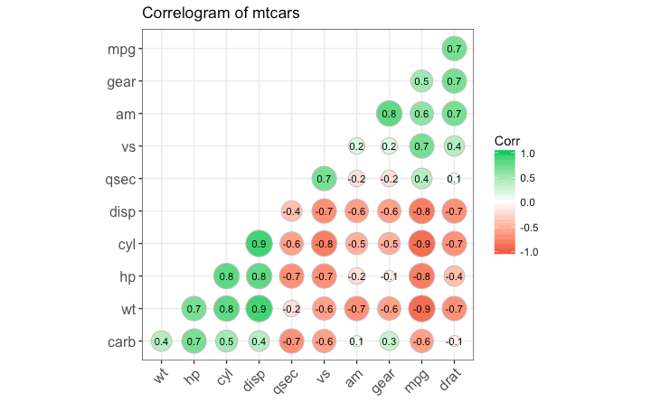
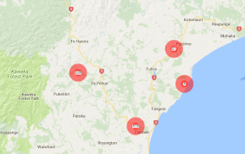
Introduction
Analysis system
Provides the means to examine, transform and visualise data with the intent of drawing conclusions, discovering useful information and supporting decision making
Notes:
IRIS has an embedded R engine. This allows for very flexible reporting.

Slide 10
Background
Custom solutions
Before IRIS Episoft gained experience from developing:
EpiMan for MAF NZ
Kodavet for Swiss Government
InfoVet (Pfizer)
Software could not evolve over time.
Hard coded rules prevented portability.
Costly to add extra features.
Notes:
All are desktop products. Issues with upgrades and installations.
Fixed roles
Software not used on a daily basis

Slide 11
Background
IRIS – Incident Response Information System
Development was funded by the European Commission through the Animal and Human Influenza Trust Fund, administered by the World Bank

Slide 12
Background
IRIS is backed by an relational database MS SQL Server
The system is based on a dynamic data storage model which allows users to modify the system to their needs over time.
All data can be geo-referenced enabling mapping and spatial analysis suited to disease control activities.
Notes:
Users can add and remove fields on the fly and rely less on IT staff.
Import data from different systems

Slide 13
Background
Multiple users can access the data concurrently and work effectively together.
Data security is built into the system using role and attribute based access control.
IRIS allows the integration of data from different sources, facilitating better decision making.
Notes:
Can store spatial data and then map the data
Data can be secured row and column level by roles
Talk about current integration work

Slide 14
Background
Provides easy to use data extraction mechanisms.
Provides flexible reporting, searching and sorting of data.
Provides methods for creating and displaying help

Slide 15
Background
Backups and system updates are handled on the server side.
Integration with other systems (Support for exposing and consuming APIs)
Others benefits: scheduled tasks, remote sensing data

Slide 16
Design
Developed using industry standard tools
Client Side: ExtJS, OpenLayers
Server Side: Microsoft .NET C#
MS SQL Server (or any of the major RDBS can be used)
Spatial data stored as WKT and GeoJSON
Language independent interface
Uses RServ for reporting

Slide 17
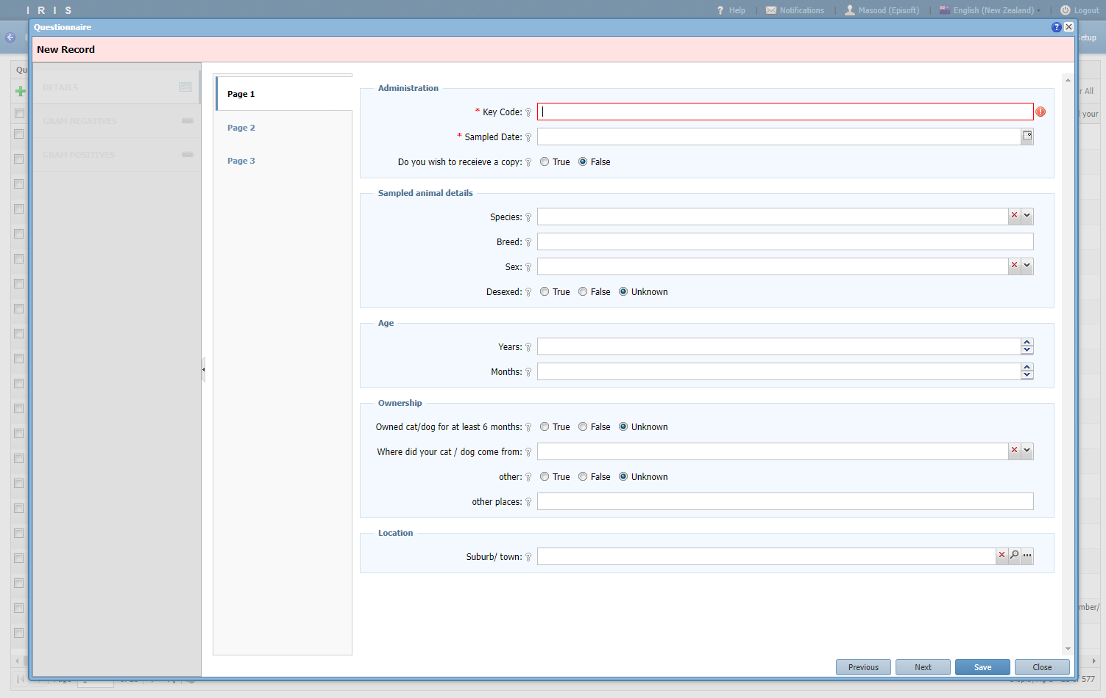
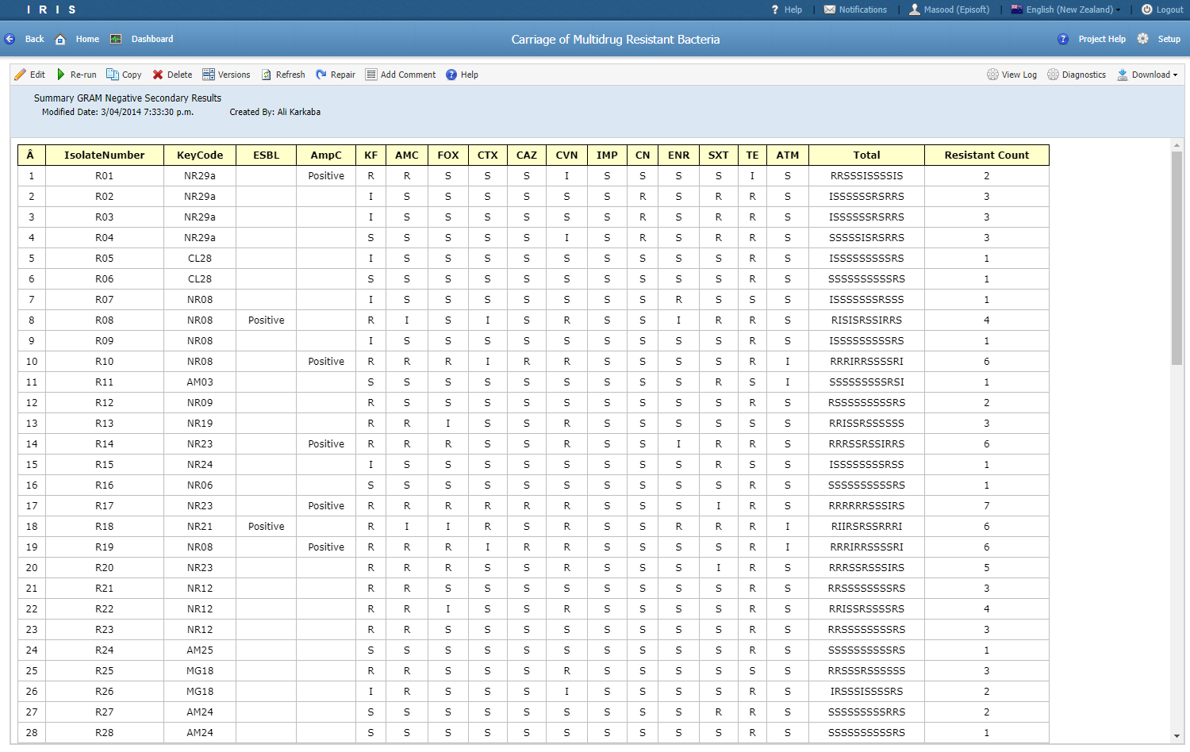
Use cases
Carriage of multidrug-resistant bacteria
IRIS was used to store the results of a survey and link the data with samples taken from cats and dogs.
The IRIS reporting engine was used to analyse the test results and create summary tables

Slide 18
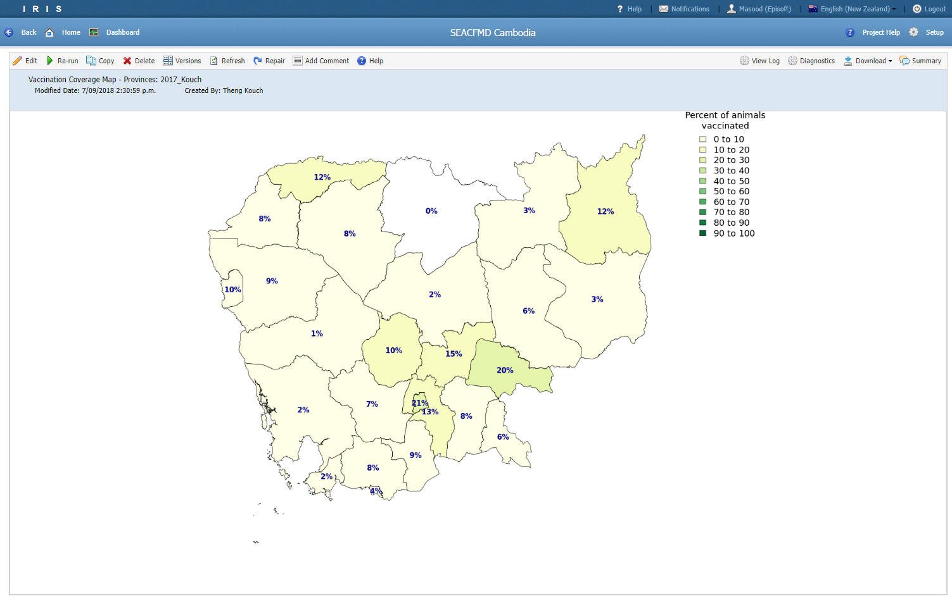
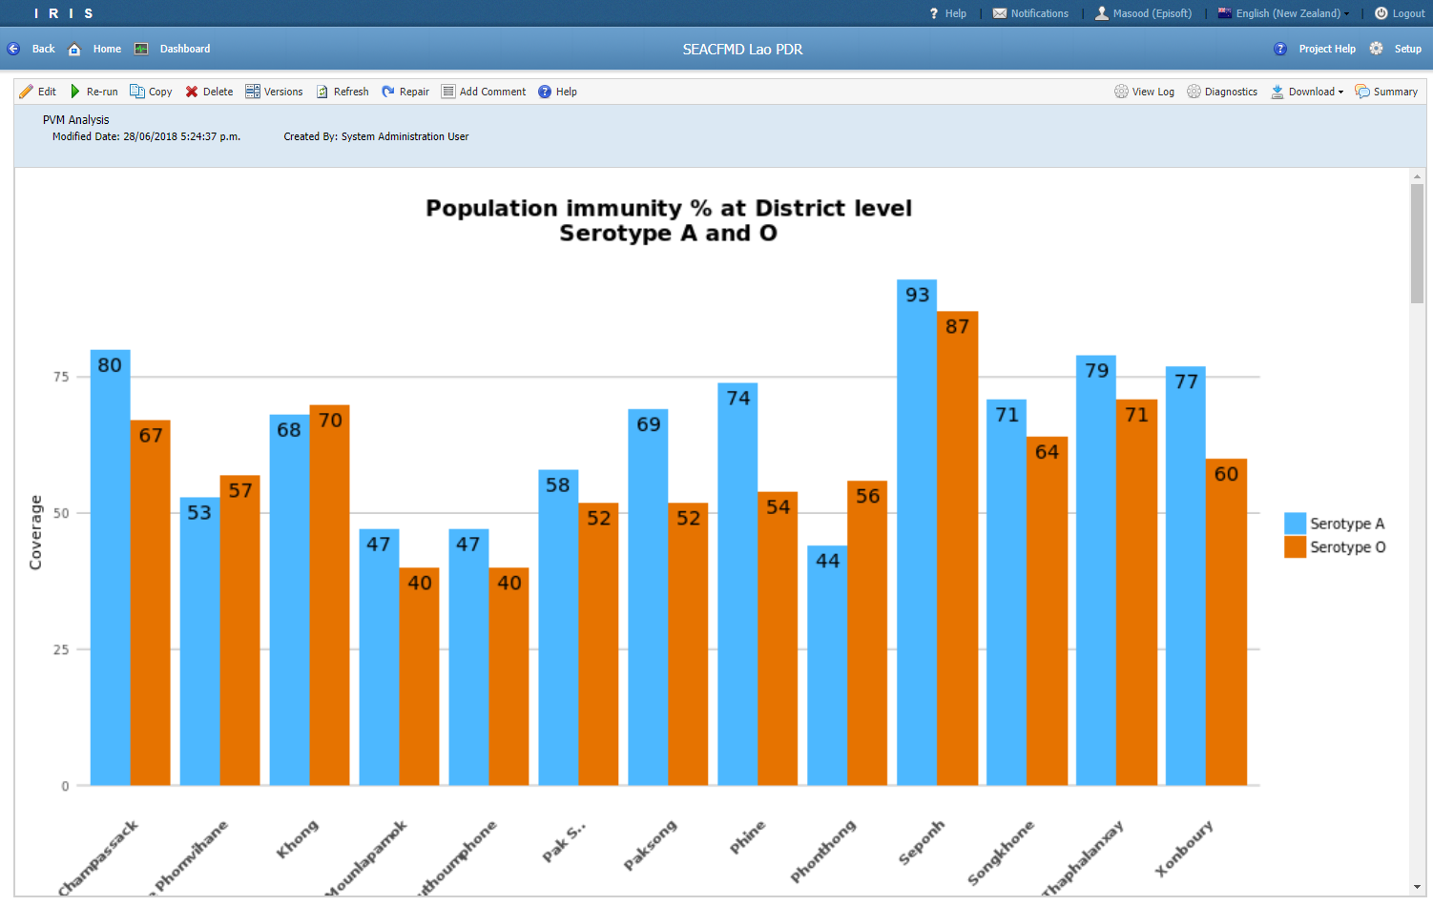
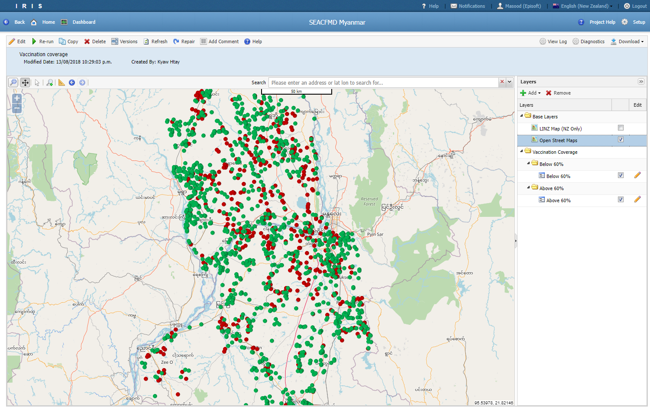
Use cases
SEACFMD Campaign
Funded by the OIE to combat foot and mouth disease (FMD) in South-East Asia and China.
IRIS was used to store survey data and results from testing and vaccination.
Helped to visual spatial coverage and trends in the data
Projects were customised to the needs of the country (Cambodia, Lao, Myanmar)

Slide 19
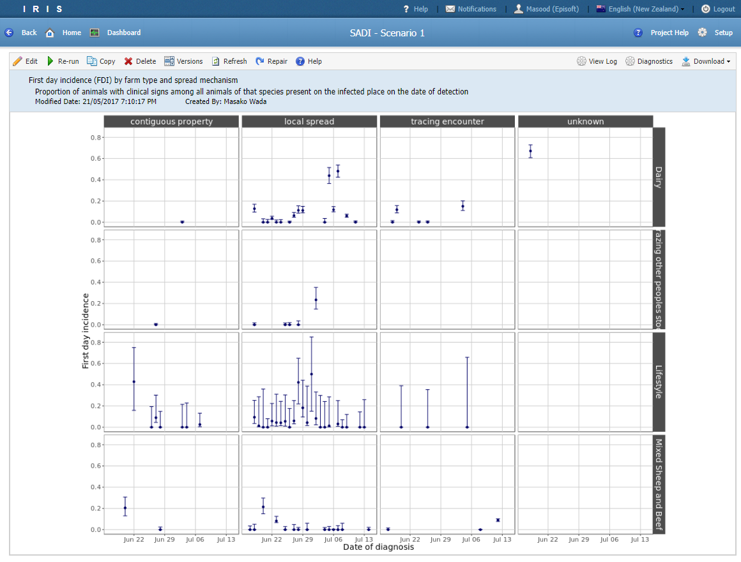
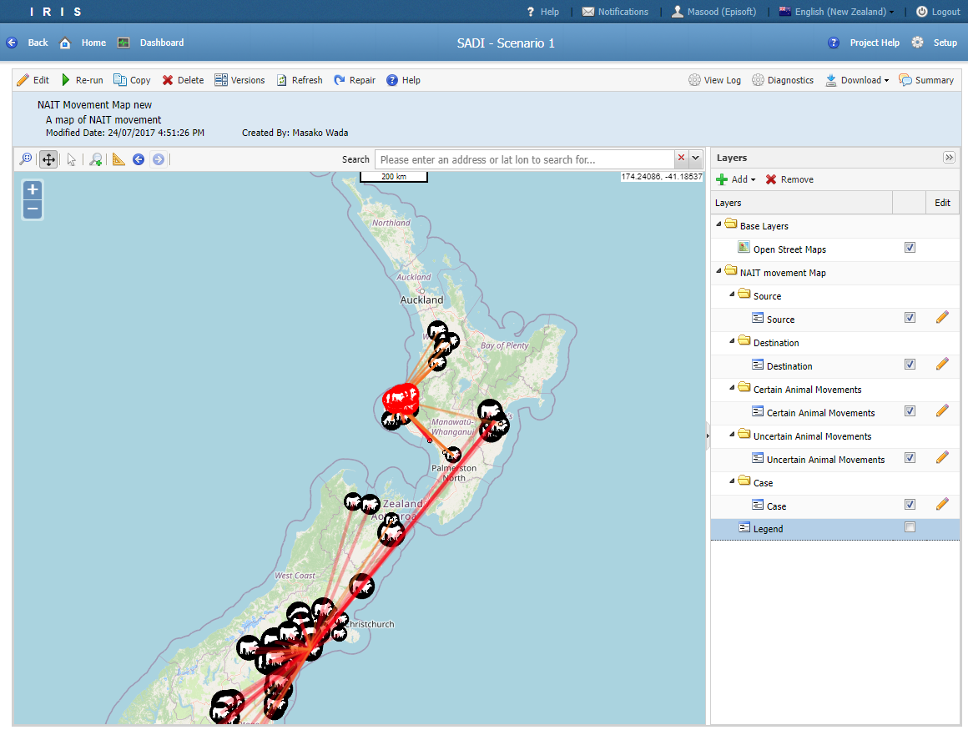
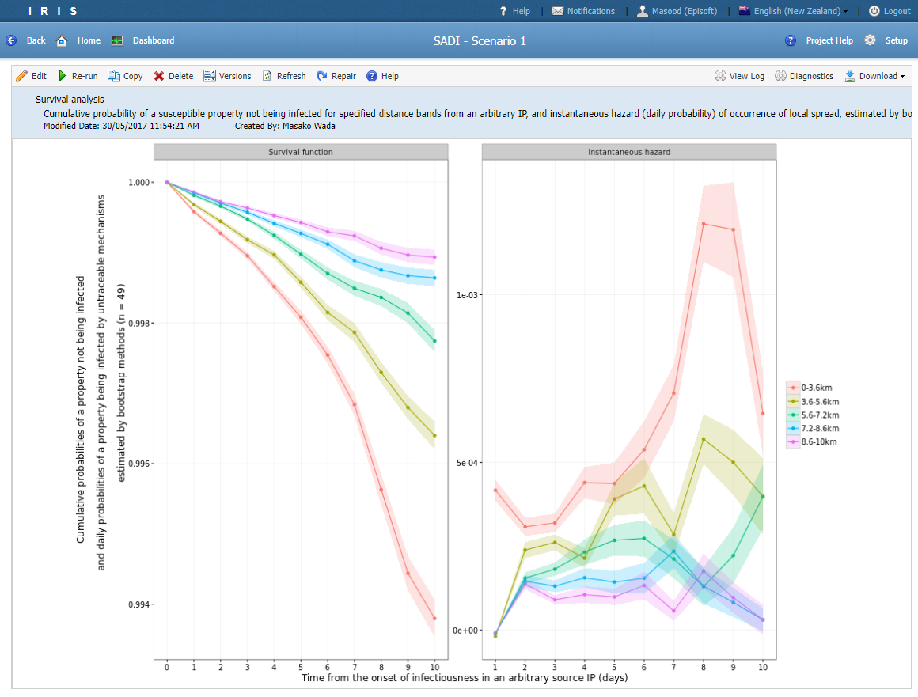
Use cases
SADI
A set of standardised analyses for disease investigation built as a project inside IRIS
Integrates national livestock data, outbreak data and tracing data
Enables routine analysis of up-to-date data to be run frequently
Used during the Mbovis outbreak

Slide 20
Use cases
MPI
Animal Health Surveillance Programme
TSE Surveillance Programme
NIMA – Notification and Investigation (Animals/Plants)
Wildlife
Mbovis SADI
Salmonella Enteritidis

Slide 21
Use cases
LIMS Template Project
PDF form
TSE Surveillance Programme
NIMA – Notification and Investigation (Animals/Plants)
Wildlife
Mbovis SADI
Salmonella Enteritidis

Slide 22
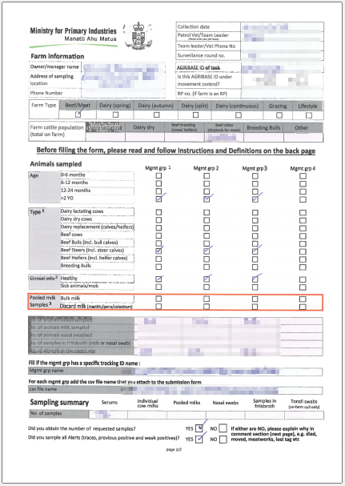
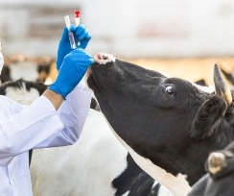
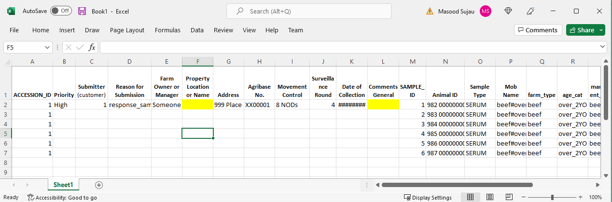
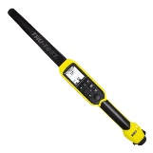
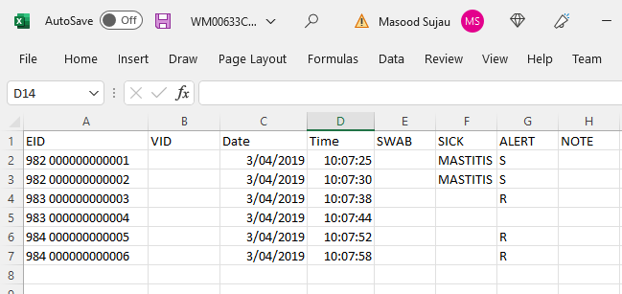
Use cases – LIMS Template
LIMS Template Project
Email
Data Entry Team
Email
Lab

Slide 23
Use cases – LIMS Template
Issues with Excel template
Manually enter data from PDF form and wand file into excel template
Fix sample number in the excel file
Limited validation in excel
Data was stored in folders on local and shared drives
When look up values changed a new template file had to be circulated
No way to track traced or previous positive animals
Manually track workload

Slide 24
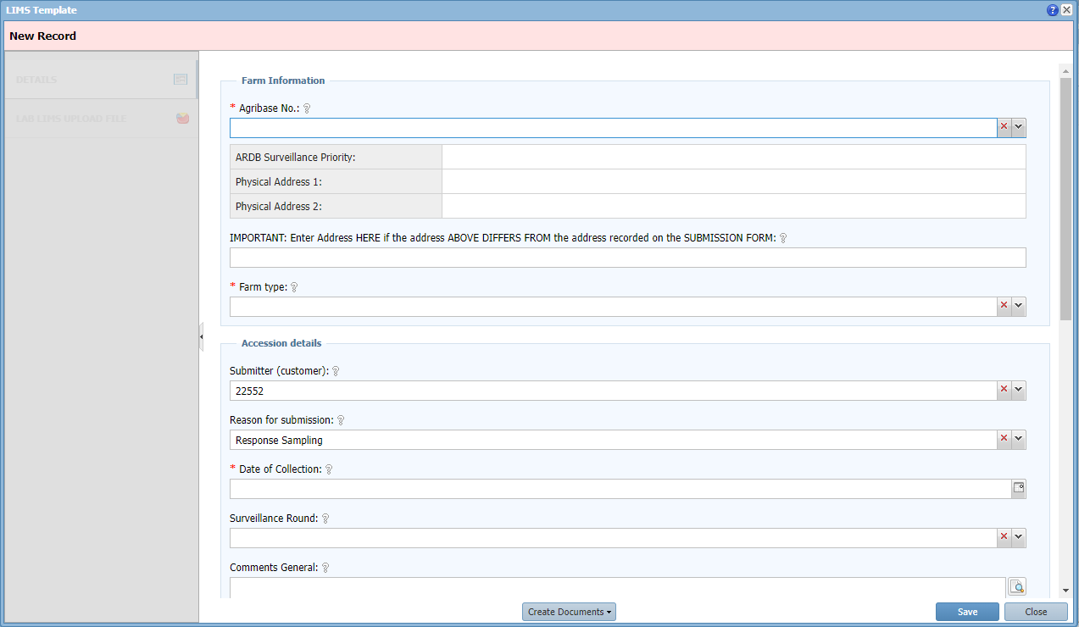
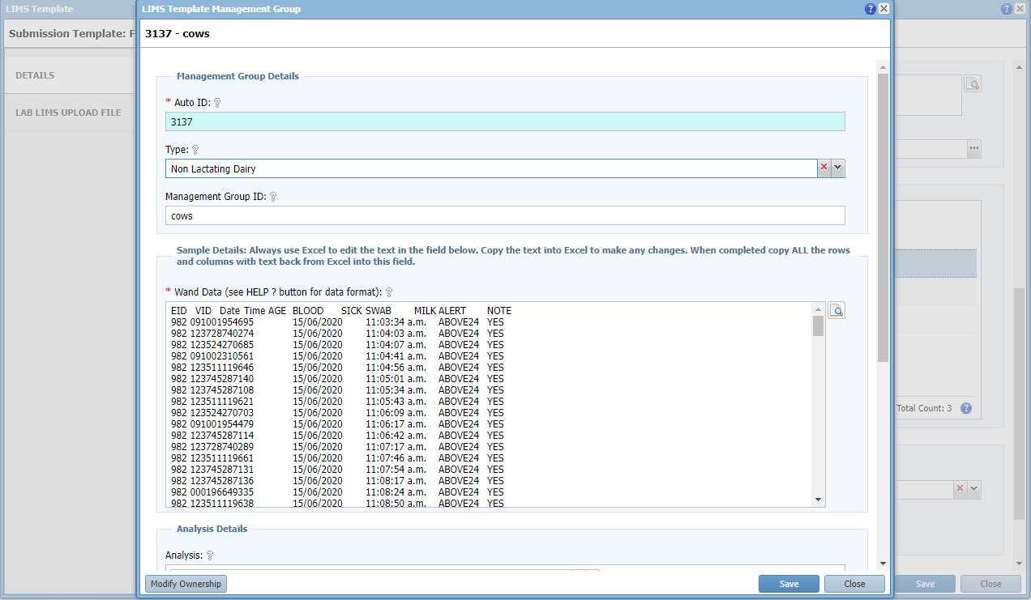
Use cases – LIMS Template
A Possible Solution
Mbovis SADI was already operational in IRIS and contained Agribase and ARDB data and was refreshed regularly
Create a separate LIMS Template project for storing farm sampling information and created a place to cut and paste wand data

Slide 25
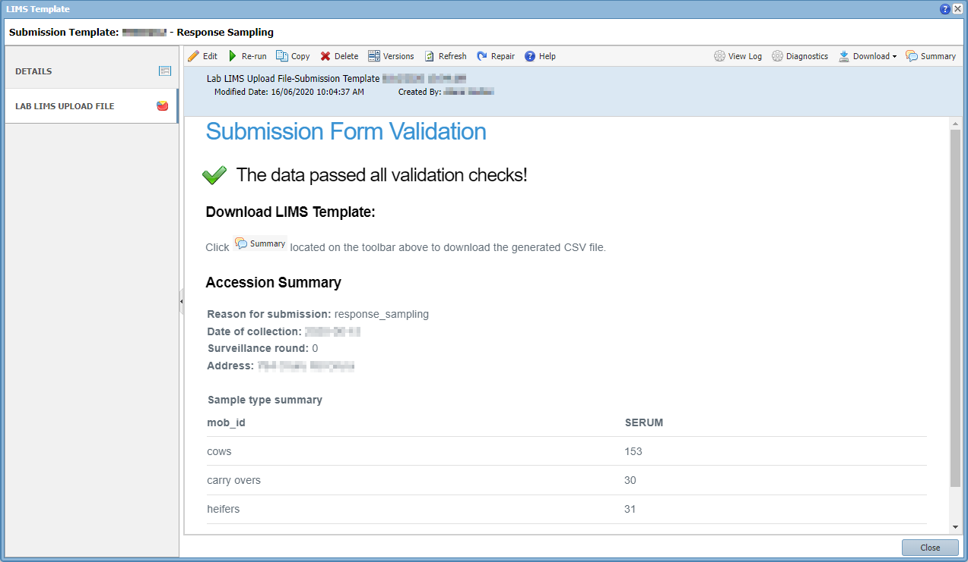
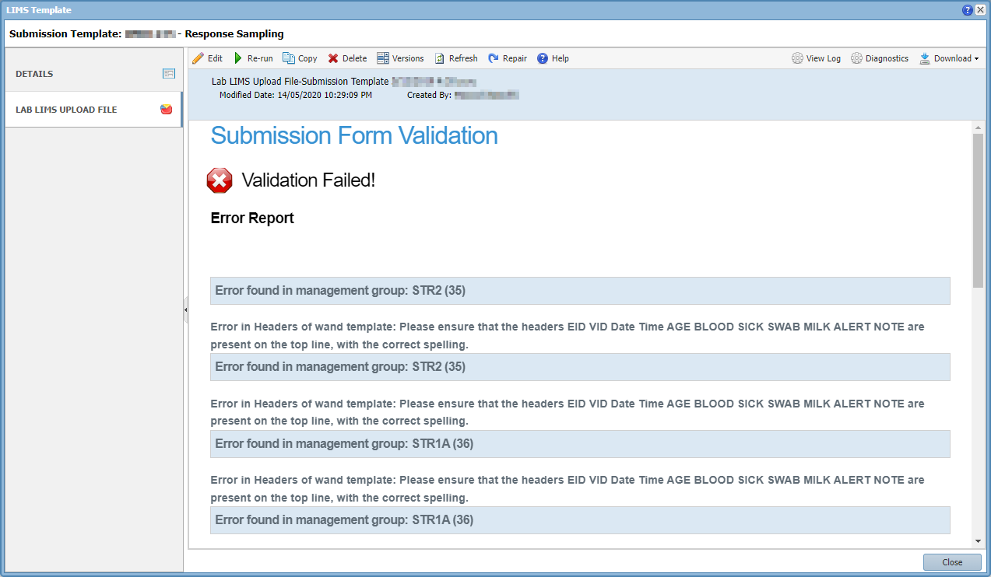
Use cases – LIMS Template
Built a report to validate the sampling information and wand data
Automated the generation of the LIMS Template file
Centralised the management of look up values
Made data entry more efficient and more accurate

Slide 26
Demo Dataset
COVID-19 dataset downloaded from MoH website on the 30th of March 2020
Consists of individual cases. 552 Confirmed and 37 probable
Contains information on
Sex | Last Country Visited
Age Group | Flight No
DHB (District Health Board) | Departure Date
Overseas Travel | Arrival Date

Slide 27
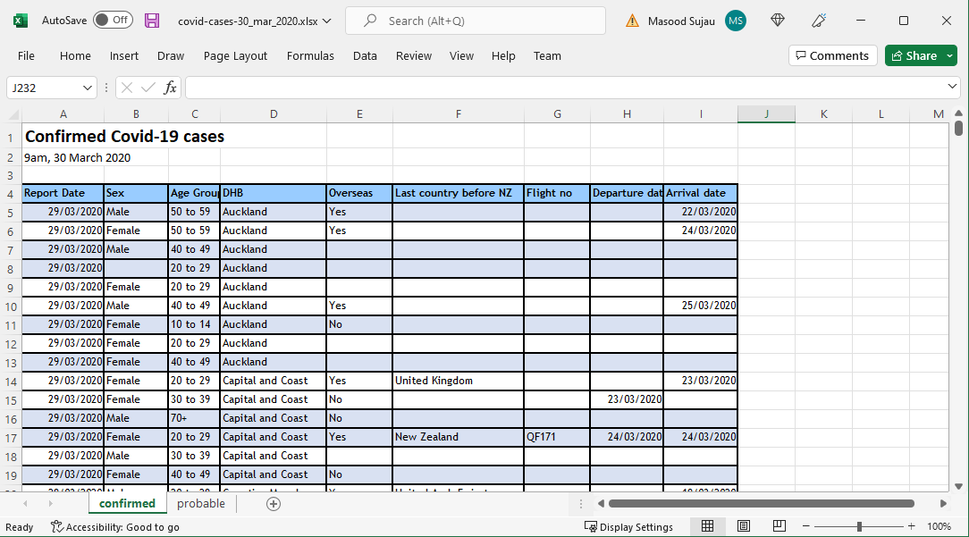
Demo Dataset
Location in GitHub Repo: /practical/data/covid-cases-30_mar_2020.xlsx

Slide 28
Quick Tour

Slide 29
Demo Dataset
Clean the data
Fix spelling mistakes
Consistent categories
Consistent date format (YYYY-MM-DD)
Combined the sheets
Added a new column Status (confirmed/probable)
Removed spaces in column names
Identify repeating data (Normalise the data)
Generate a model

Slide 30
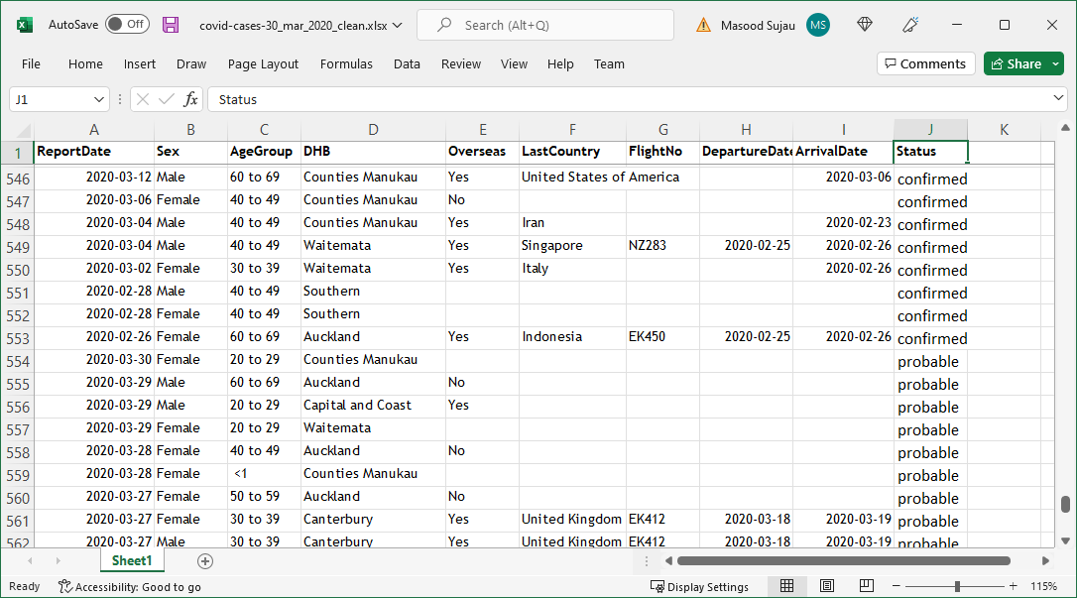
Demo Dataset

Slide 31
Demo Dataset
Sex
Female
Male
Age Group
< 1
1 to 4
5 to 9
10 to 14
. . .
Country
Argentina
Australia
Austria
Belgium
Cambodia
. . .
DHB
Auckland
Capital and Coast
Counties Manukau
MidCentral
. . .
Oversease
Yes
No
Status
Confirmed
Probable

Slide 32
Demo Dataset
Sex
Country
Covid-19 Case
Age Group
Status
DHB
Overseas

Slide 33
IRIS Terminology
Tables | A bucket to store data
Filters | View of the data across one or more tables
Reports | Present data in graphic or tabular form
Roles | Grouping of users to control access to data
Labels | Grouping of Filters and Reports
Projects | Grouping of related tables, filters and reports
Domain | Grouping of Projects

Slide 34
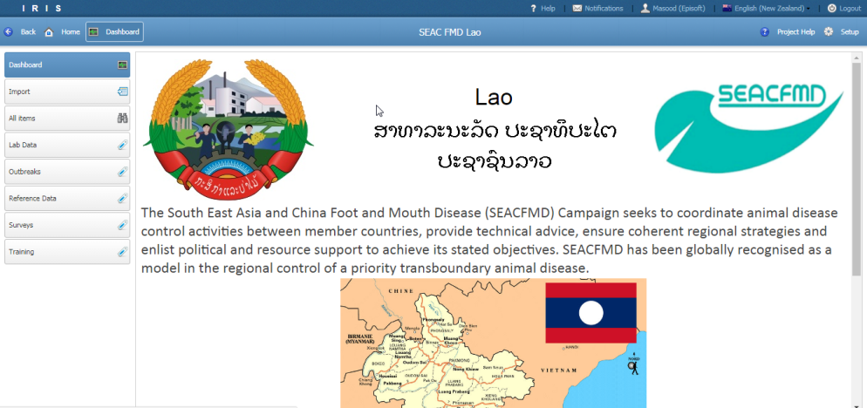
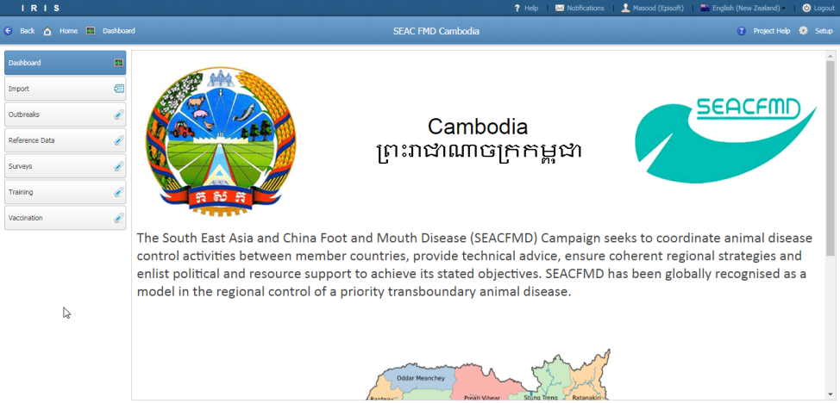
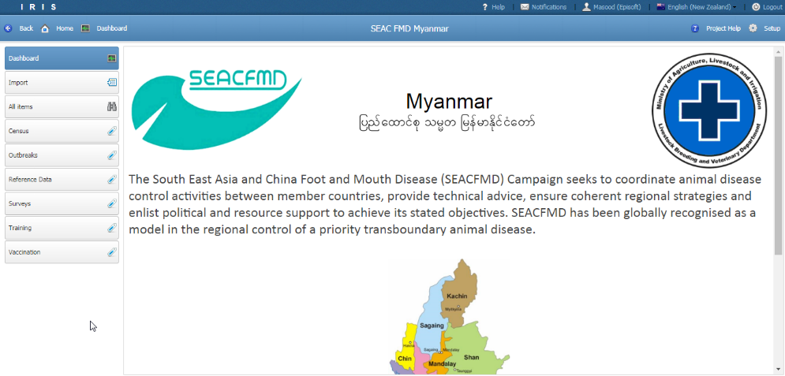
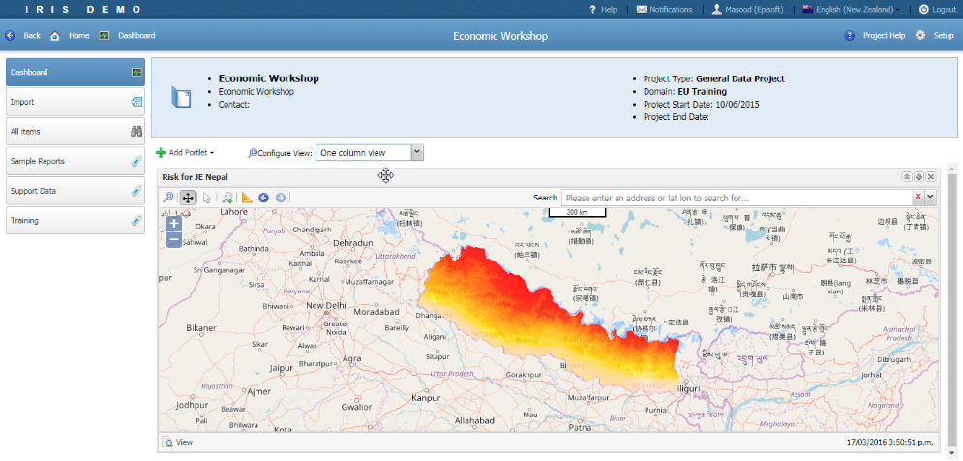
Projects
Grouping of related data
Notes:
- Similar to a single Access database

Slide 35

Projects
Setup
Import data
Labels

Slide 36
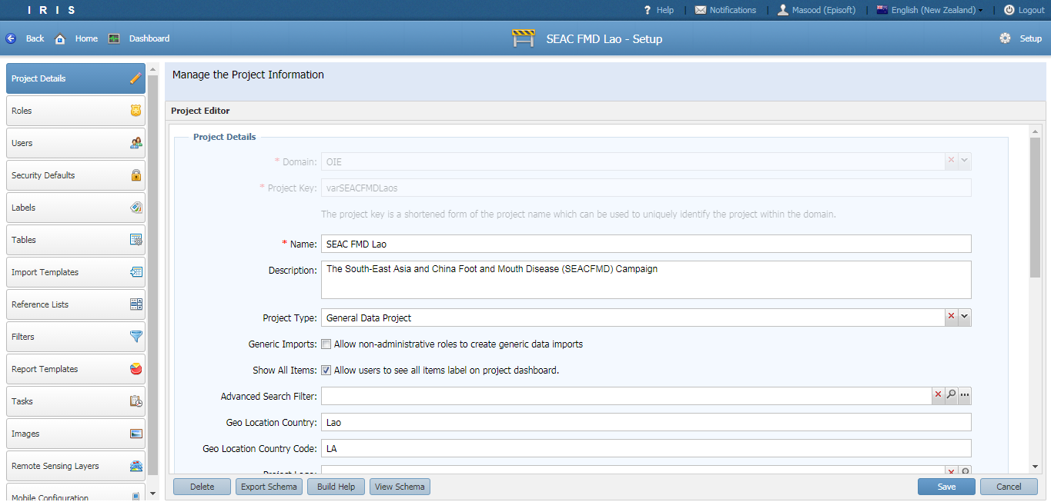
Projects - Setup

Slide 37
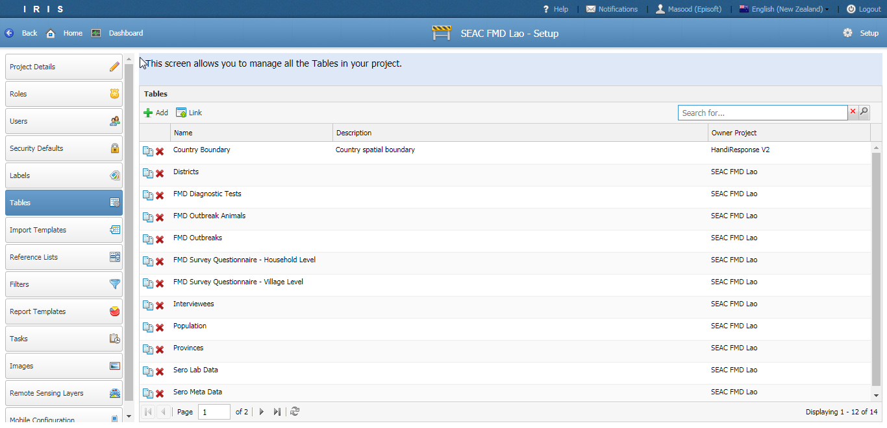
Tables

Slide 38
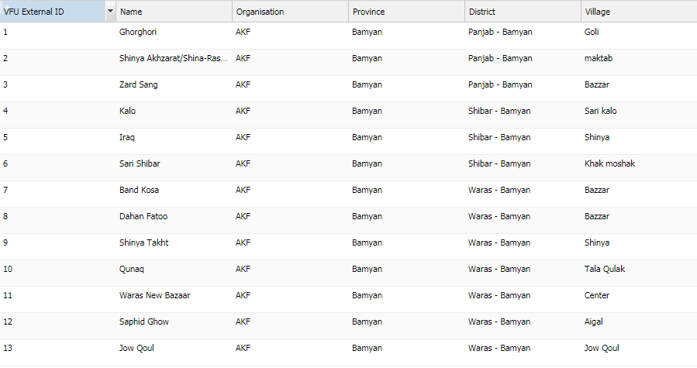
Tables
Made up of a collection records and fields
Field stores a single type of data
Records contain a collection of fields
Notes:
A table is similar to an Excel sheet
A field is like a column in an Excel sheet
Each field holds a specific type of data
You can specify rules for the type of data and formatting
A record is like a row in an Excel sheet

Slide 39
Table
Table store many different types of data. E.g. People, Animals, Places, Events etc.
Fields can be added and removed dynamically at any time.
Data can be secured at the table level, field level or row level.
IRIS generates forms from records for easier data entry
Help built into Tables and Fields

Slide 40
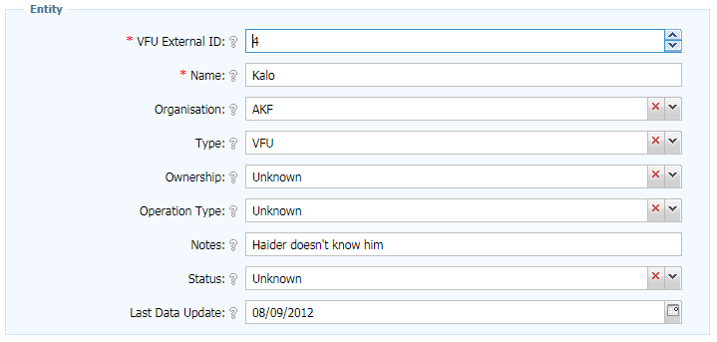
Tables
Notes:
Similar to a spreadsheet
More control over types of data that can be input

Slide 41
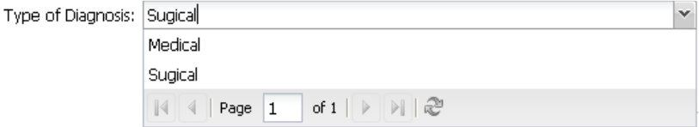
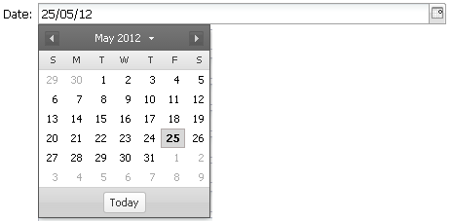
Tables - Fields
Field can be of the following types
Text
Numeric
Date and Time
Boolean (Yes/No)
Reference list (look ups)
Spatial
Relationships
Binary (Images/PDF)

Slide 42
Tables -Fields
Support validation
Required, Minimum, Maximum etc.
Assign default values
Can change the type of control to render
Control who can read, update and delete data in the field
Create help to assist data entry as tool tips or a help page

Slide 43
Tables -Fields
One unique field per table
Supported types: String, Number, Date, Auto-number
Used for data imports to do matching

Slide 44
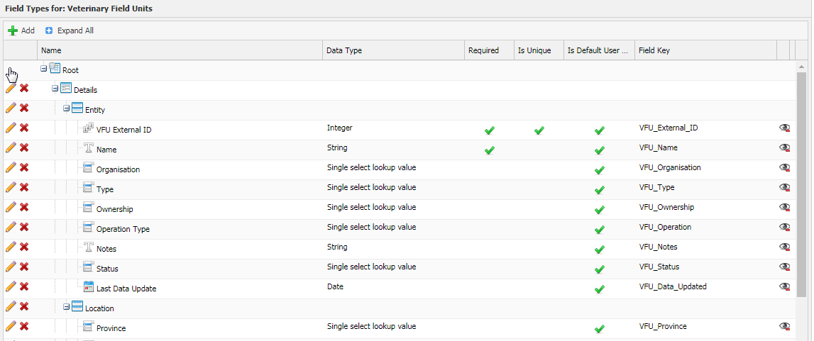
Tables – Fields
Table designer
Level 1: Forms
Level 2: Sections
Level 3: Fields
Notes:
Use the table designer to create tables
Tree of components
First level is always a “Form”
Second level is always a “Section”
Fields can be added only into “Sections”
Click the parent node to enter the type of component you want.

Slide 45
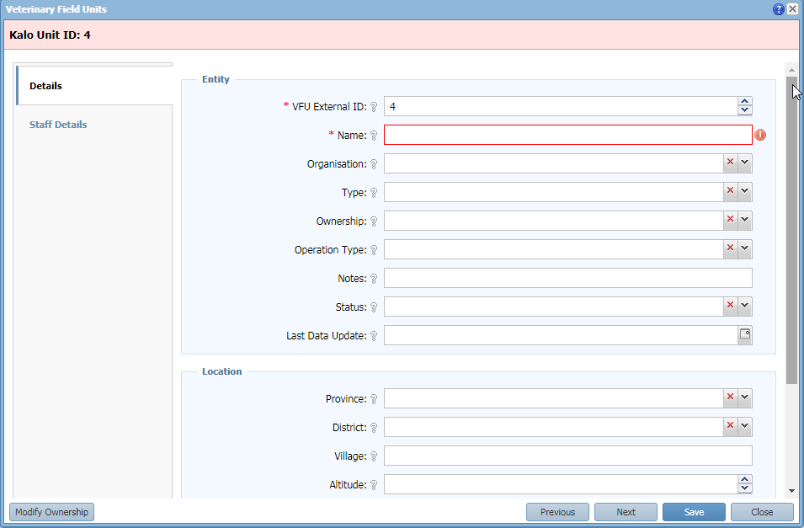
Tables – Forms
Table designer
Section
Form
Field
Notes:
Use the table designer to create tables
Tree of components
First level is always a “Form”
Second level is always a “Section”
Fields can be added only into “Sections”
Click the parent node to enter the type of component you want.

Slide 46
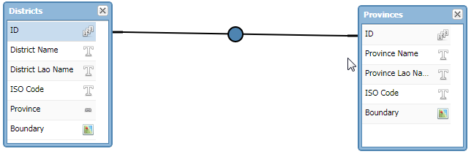
Tables - Relationships
Single relationships
When many rows from Table A (Districts) are linked to a single row in Table B (Provinces).
Also known as a many-to-one relationship.
many
one
Notes:
- To avoid repeating data, you want to create relationships between data

Slide 47
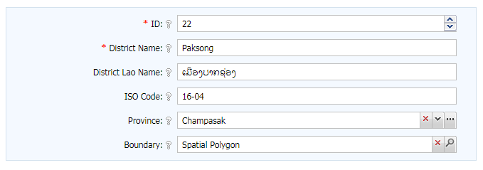
Tables - Relationships
Data is input through a dropdown list or trigger field.
Only ONE value can be picked

Slide 48
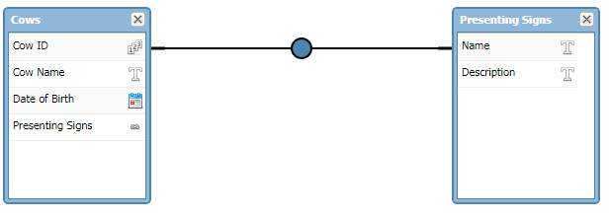
Tables - Relationships
Multi-relationships
When many rows from Table A (Cows) are linked to a many row in Table B (Presenting Signs).
Also known as a many-to-many relationship.
many
many

Slide 49
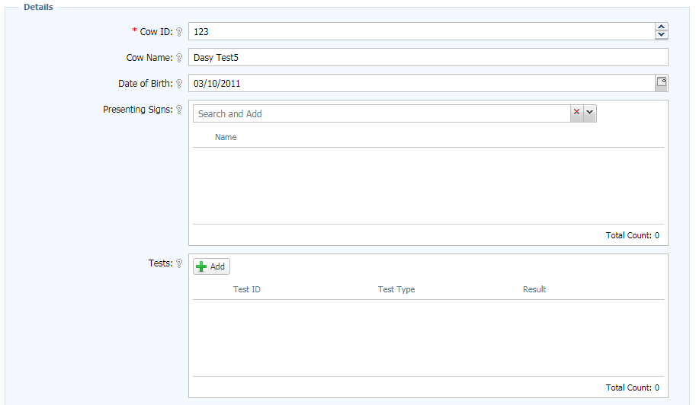
Tables - Relationships
Data is input through a list field.
MULTIPLE values can be picked or added

Slide 50
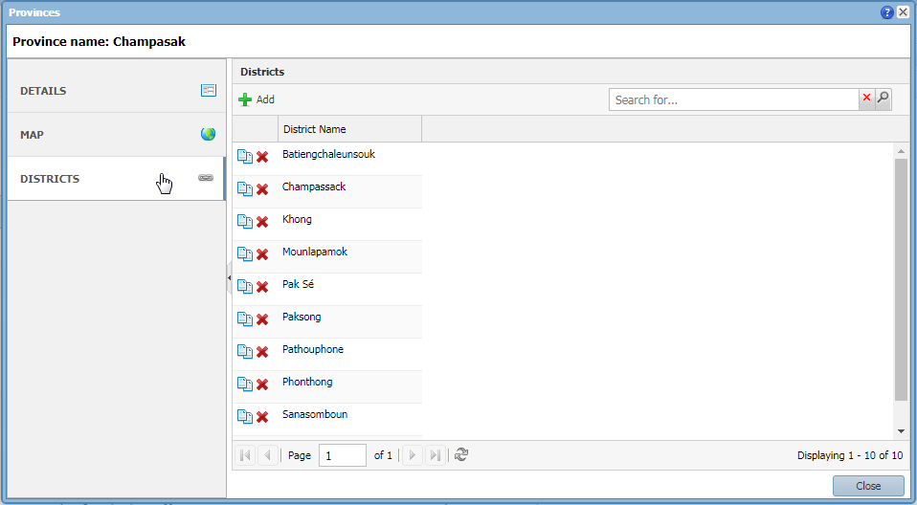
Tables - Relationships
The system automatically generates the opposite/inverse relationship

Slide 51
Importing data
Supports import from CSV and XML format
Preferred data formats
Date: yyyy-MM-dd
Date and Time: yyyy-MM-dd HH:mm:ss
Boolean: (true/false) (T/F) (1/0) (yes/no)
Reference List: Use the key
Relationships: Use the unique key
Text: Always quote the text “ “

Slide 52
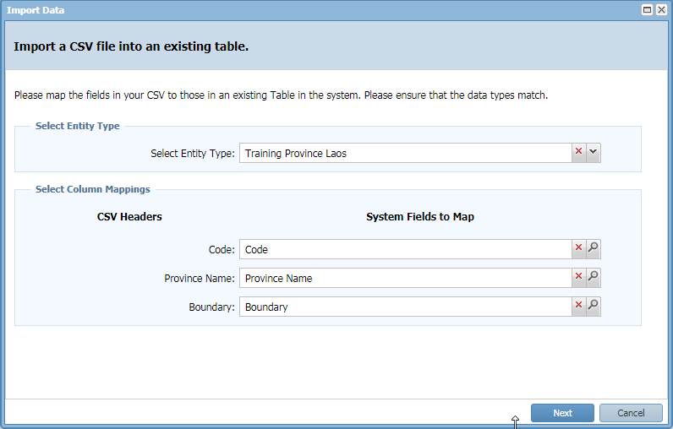
Importing data

Slide 53
Importing data
For repeated data importing you can use an Import Template
For XML data only Import Templates are supported

Slide 54
Labels
Labels

Slide 55
Labels
Labels provide a menu system to navigate a project
Keep related filters and reports under the same label
If only one item is under a label then the system navigates straight to that item

Slide 56
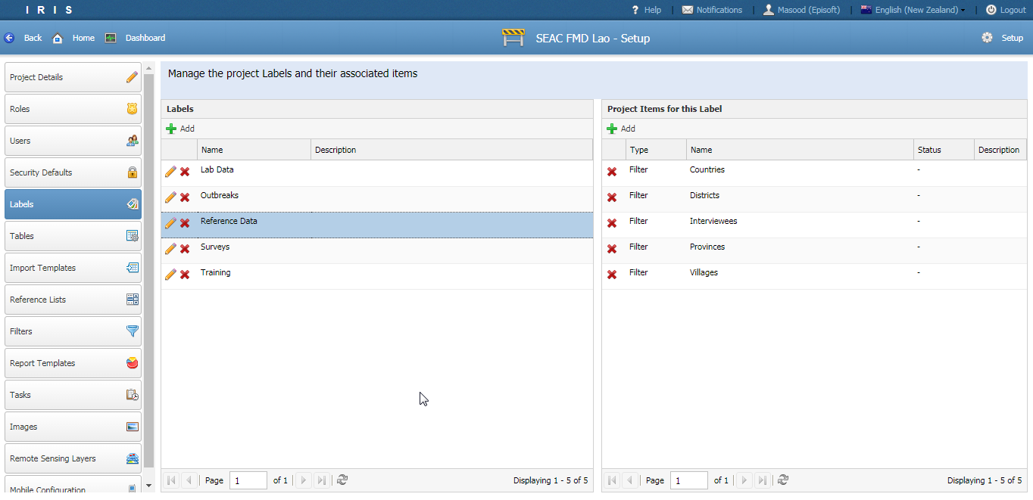
Labels

Slide 57
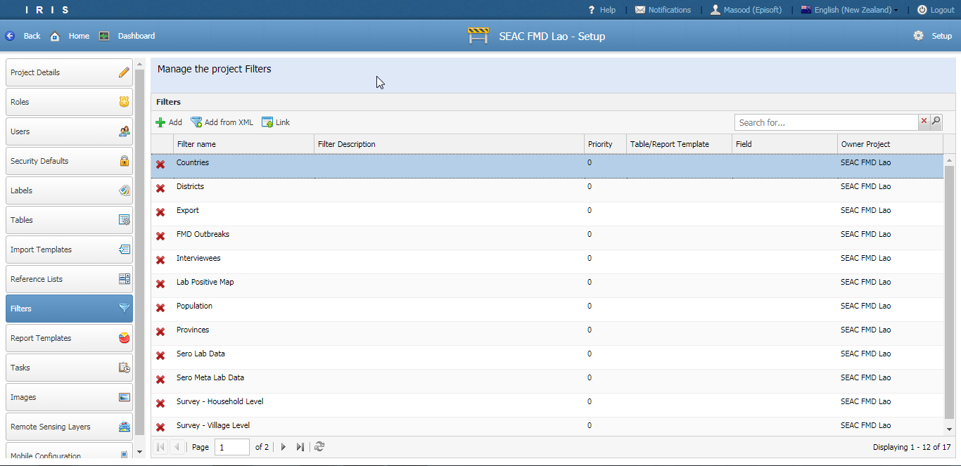
Filters

Slide 58
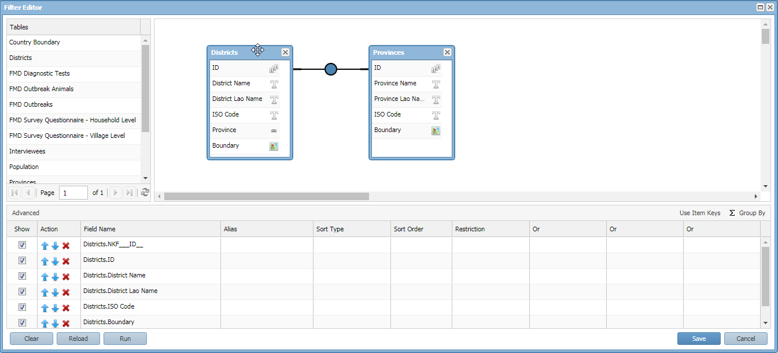
Filters
A view of the data stored within one or more tables.
Notes:
It is the equivalent of a query in MS Access
Pick the Table(s) of interest
IRIS automatically creates the relationships
Pick the fields of interest
Run/Save
Additional features include aggregate functions, sorting

Slide 59
Filters
Function | Details | Data Types
Sum | Adding all the data | Integer, Double
Average | Averaging the data | Integer, Double
Min | Minimum value | Integer, Double, Date
Max | Maximum value | Integer, Double, Date
Count | Count the number of occurrences | Integer, Double, Date, String
Concatenate | Join the values by string | String

Slide 60

Filters
Running a filter produces a grid of data
Toolbar
Search
Spatial field

Slide 61

Filters - Maps
If a spatial column is present then the data can be mapped.

Slide 62

Filters - Search
Google type search vs parameter search

Slide 63

Report Templates & Reports

Slide 64
Report Templates & Reports
A report template executes R Code with some input parameters to produce a Report.
As an end user you will only need to provide the input parameters.
The parameters depend on the type of Report Template.
A common input parameter is a Filter which provides the data to analyse

Slide 65

Report Templates & Reports
Report Templates
Reports

Slide 66



Report Templates & Reports
Report outputs can be an image, KML, text file or HTML
HandiMap is a Report Template for producing risk maps using remote sensing data

Slide 67

Roles

Slide 68
Roles
Roles are a method of grouping users in a project by job or function
Project default roles
Project Manager
Member
Additional roles can be created (E.g. Interviewer, Data entry, Lab technician etc.)
Notes:
Other roles include: System Administrator, Domain Administrator, Domain member and Everyone

Slide 69
Roles
Component security
Deals with securing component structure.
E.g. Interviewer role can not change the table name or add fields
Data security (aka “Data Policies”)
Deals with securing data inside a table
E.g. Users in the Interviewer role can only change their own records

Slide 70
Roles
Roles are assigned permissions to secure project components.
E.g. “Interviewer” can not add fields
Project
User
Role
Read, Update Delete
Project Component
Tables, Filters, Reference lists, Reports

Slide 71

Roles
Component security permission assignment.
Permissions
Notes:
Hover to see the permission
Security needs to be well thought through

Slide 72
Questions?
Contacts
http://wiki.episoft.co.nz
masood.sujau@haloratech.com
bryan@episoft.co.nz

Slide 73
Exercise
Site: http://demo.episoft.co.nz
Username: <Your email>
Password: 12348765

